Slide 1
Sir Gawain and the Green Knight Ivanhoe – Walter Scott
Appreciation of English and American Literature – Week 3

Slide 2
Old English and Middle English
Tell your classmates something interesting about Old English and/or Middle English.
Tell them something interesting about Beowulf or The Canterbury Tales.

Slide 3
When you read, where does meaning come from? (semiotics/semantics – the study of meaning)
Is it from the words of the text?
Does the writer communicate his/her meaning through the text?
To what extent do you, the reader, give meaning to those words?
We’ll also think about how our view of history is shaped by the text –
how the events in the poem/prose are historicised:
(when something is made into history in a certain way).

Slide 4
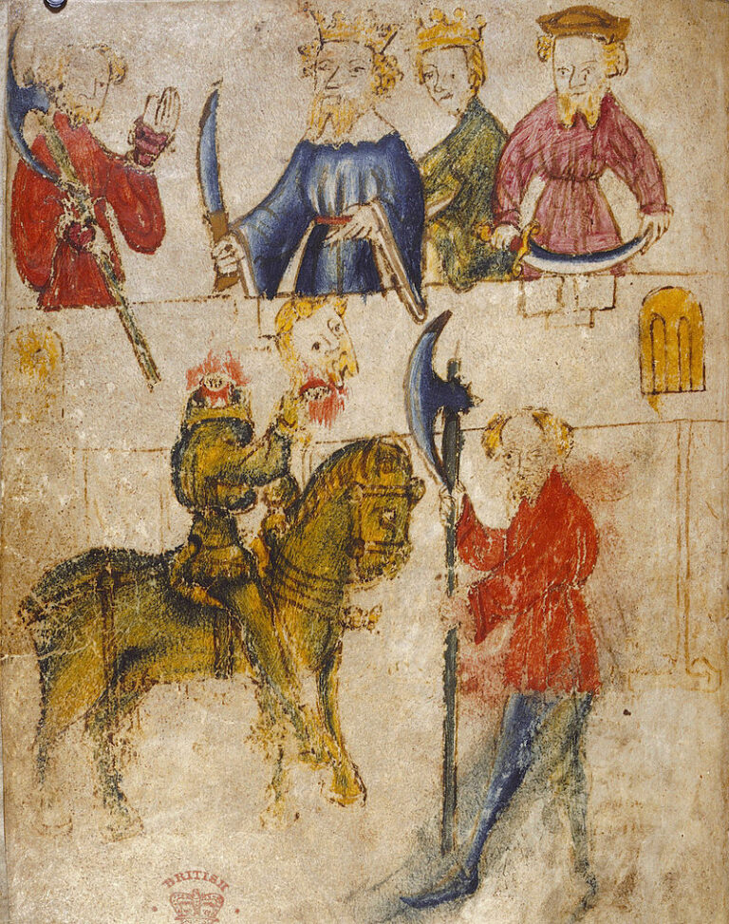
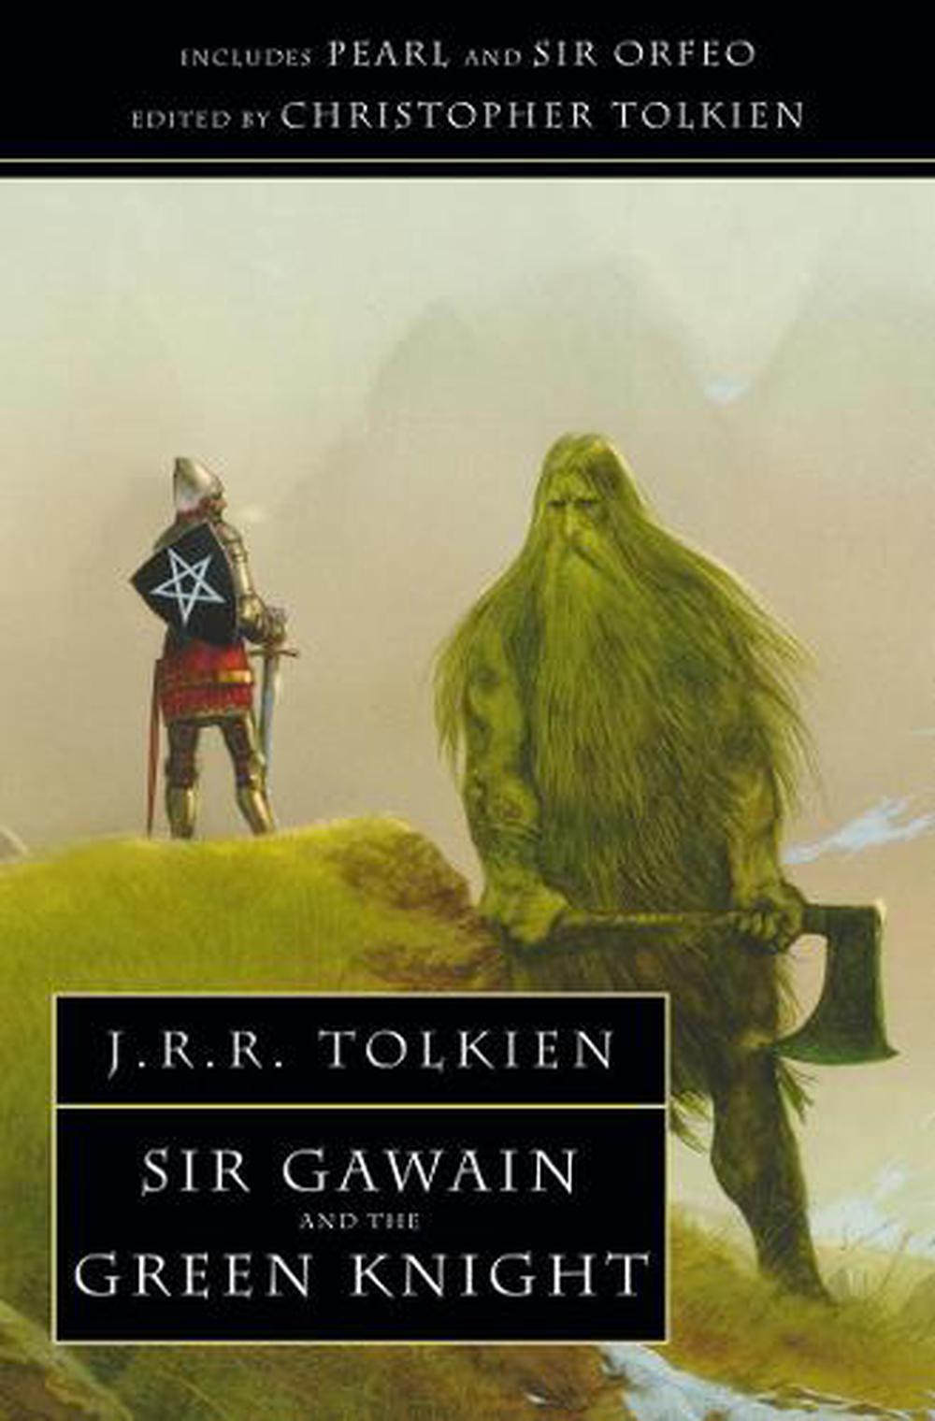
Sir Gawain and the Green Knight
Briefly summarise the story with your classmates.
Where does the story begin?
Why does Gawain have to go on a perilous quest?
Where does he go?
What happens to him on the way?
What happens at the end with the Green Knight?
What does Gawain learn from his quest?

Slide 5
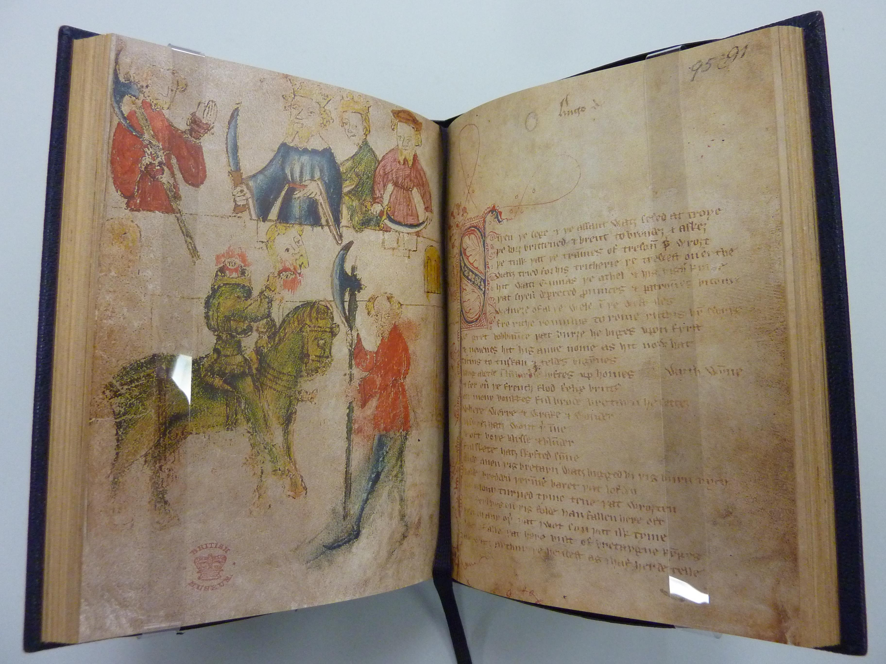
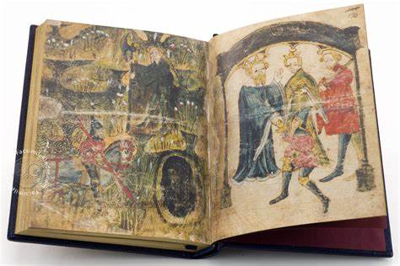
Sir Gawain and the Green Knight
It is a chivalric romance from around the 14th Century, written by an unknown author, in Middle English (but using many words from a northern dialect).
It is part of the ‘Pearl Manuscript’ of which there is only one copy surviving.

Slide 6
Sir Gawayn and þe Grene Knyȝt
First of all, can you see any stylistic techniques: any rhythms, or poetic metre?
Passus I
SIÞEN þe sege and þe assaut watz sesed at Troye,
Þe borȝ brittened and brent to brondeȝ and askez,
Þe tulk þat þe trammes of tresoun þer wroȝt
Watz tried for his tricherie, þe trewest on erthe:
Hit watz Ennias þe athel, and his highe kynde,
Þat siþen depreced prouinces, and patrounes bicome
Welneȝe of al þe wele in þe west iles.
Fro riche Romulus to Rome ricchis hym swyþe,
With gret bobbaunce þat burȝe he biges vpon fyrst,
And neuenes hit his aune nome, as hit now hat;
Tirius to Tuskan and teldes bigynnes,
It has an ‘alliterative metre’. Many lines have ‘two pairs of stressed syllables’, using repeating sounds that build a rhythm.

Slide 7
Langaberde in Lumbardie lyftes vp homes,
And fer ouer þe French flod Felix Brutus
On mony bonkkes ful brode Bretayn he settez
wyth wynne,
Where werre and wrake and wonder
Bi syþez hatz wont þerinne,
And oft boþe blysse and blunder
Ful skete hatz skyfted synne.
It’s very difficult to translate this into Modern English and yet still keep the qualities of the original.
If we change the words and sounds, we inevitably change the rhythm and flow, and its effects upon the meaning.
The last four lines of each stanza are a ‘rhyming quatrain’ – four lines that rhyme, ABAB.
The ending is referred to as ‘a bob and a wheel.’

Slide 8
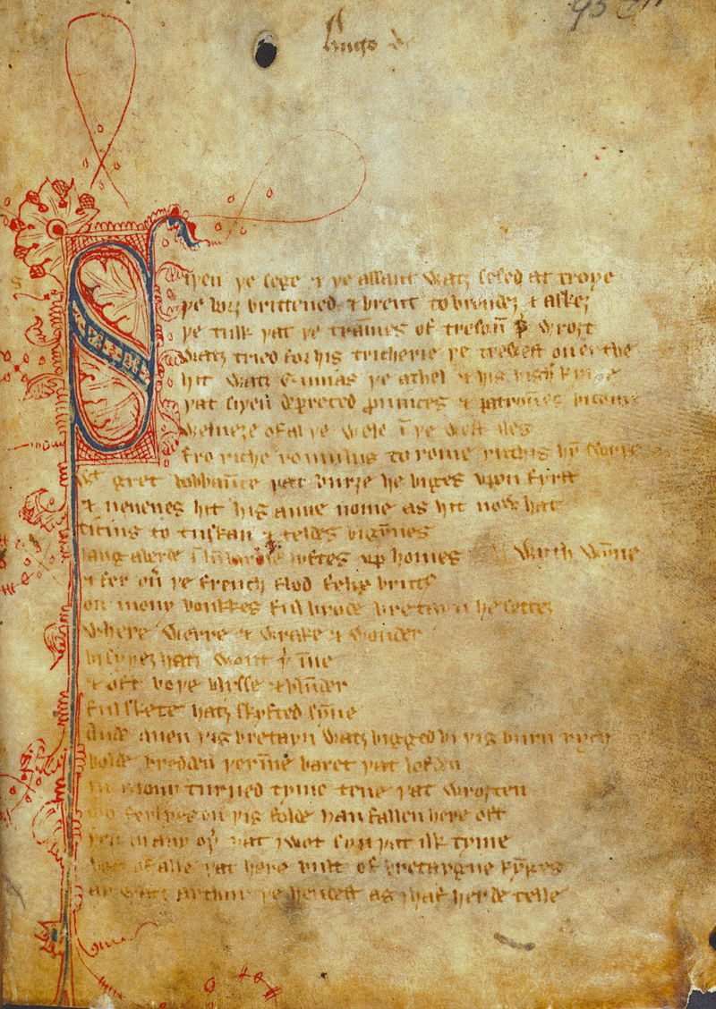
Questions - Homework Excerpts Stanzas 3 and 8
What is the setting at the start of the poem?
Who enters their New Year meal?
Who is King Arthur?
The first page of the poem in the ‘Pearl Manuscript.’

Slide 9
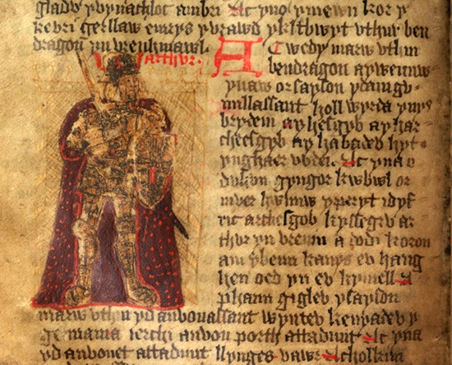
King Arthur and the Knights of the Round Table
Early Welsh sources record Arthur as a military leader fighting for the Britons against the Saxons in the 6th Century AD, after the Romans have left.
Geoffrey of Monmouth wrote The History of the Kings of Great Britain (Historia regum Britanniae) in 1136 AD, saying he was translating from a very ancient book. He described King Arthur with many details, which then became well-known.
King Arthur in a Welsh Translation of The History of the Kings of Great Britain

Slide 10
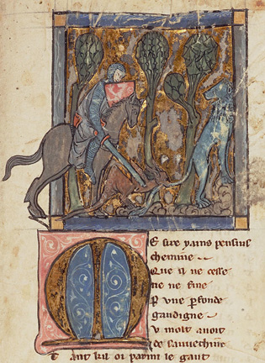
King Arthur and the Knights of the Round Table
Chrétien de Troyes, wrote Arthurian romances in Old French from around 1170-90. Some featured Gawain or other Knights, such as Yvain, the Knight of the Lion (1180)
By the time that Gawain and the Green Knight was written in Middle English in the 14th Century, most people who read it, or heard it read, would have been familiar with a range of ‘Arthurian’ stories.
The context and subjectivity of the reader can be said to have an influence on how a text is understood.
Yvain and the Lion

Slide 11
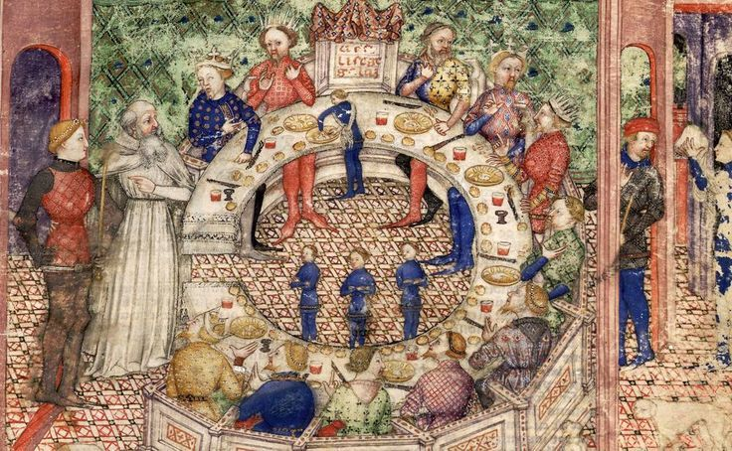
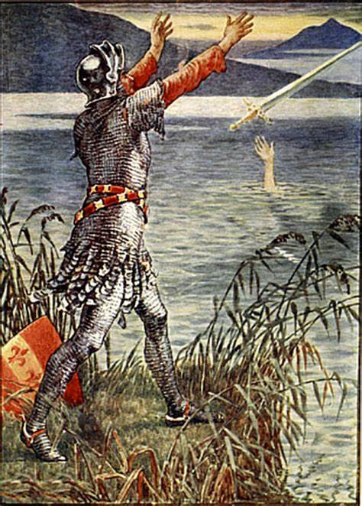
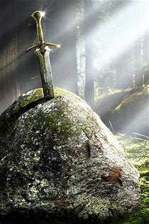
King Arthur and the Knights of the Round Table
The pious knight Galahad in art for Thomas Mallory’s 15th century prose Le Morte D’Arthur
Details that were later added of the lady in the lake giving Arthur Excalibur, and the sword in the stone.

Slide 12
Literary Terms
Intertextual – when a text has connections within it to another text – and those connections affect how we interpret its meaning. (Yet the text is still the text and holds meaning!)
This could be a “direct quotation”, or a reference to another writer or text.
It could be a phrase: if I write in my story, ‘To do this or not to do this, that is the big question’ – then most English readers these days would read it intertextually, drawing on some knowledge of Shakespeare.
It could be a structure, which references another text: ie., if I write a poem about a bird in the same structure and style as ‘The Eagle’, we could call it intertextual – your knowledge of ‘The Eagle’ would make you interpret my poem a bit differently.
It could be a genre or form that adds meaning. So, a 14th century reader reads ‘Gawain and the Green Knight’ in relation to other stories about Arthur, Gawain, and knights. This could be described as the text’s intertextuality.

Slide 13
Literary Terms
Paratextual – the other materials that are produced or associated with the text and affect how we interpret its meaning.
The cover of a book.
The art inside a book.
The movie adaptation of a book, the movie posters, the advertising, etc.
The computer game, which lets you adventure in the book’s story-world.
The author’s name.
The font the words are written in.
The paper/screen you read from.

Slide 14
Questions - Homework Excerpts Stanza 19
What happens when Gawain takes his strike with the axe?
What shocking thing happens next?
A ‘beheading game’ is found in the 8th century Irish story Fled Bricrenn. It was well known from Irish myths, and Arthurian romances.
It gives the hero a chance to show he will keep his chivalric pledge, and can bravely face death.

Slide 15
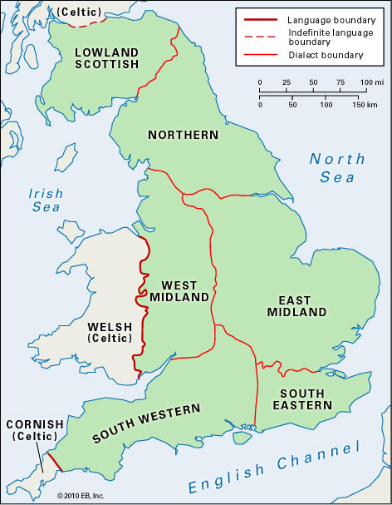
Gawain’s Journey
Gawain travels from the West Midlands, past Wales, to a forested land.
He fights wolves, dragons, wild men… and must also survive the cold.

Slide 16
Questions - Homework Excerpts Stanzas 45, 60, and 74
Stanza 45 – What agreement does Gawain make with the lord of the castle?
Stanza 60 – What tests does Gawain face? How does the lady refer to chivalry and courtly love?
Stanza 74 – What gift does Gawain accept?

Slide 17
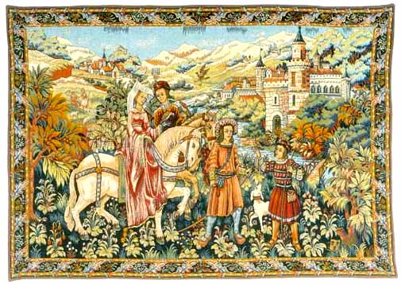
Knights and Chivalry
Chivalric culture developed in Europe, particularly by the 11th and 12th centuries. It was influenced by Christian beliefs, and also the legacy of warrior culture.
Compared to Beowulf, the knights of Arthurian Romances have a (purported) higher code of conduct.
Yet, they do not always live up to the ideals – sometimes they betray each other or sin in other ways.

Slide 18
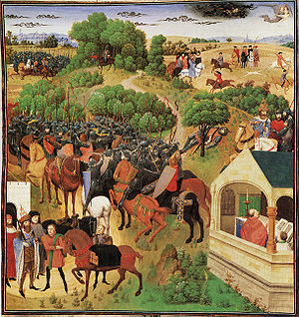
Song of Roland (an epic French poem, 11th Century)
Fear God and His Church
Serve the liege Lord in valour and faith
Protect the weak and defenceless
Live by honour and for glory
Respect the honour of women

Slide 19
Questions - Homework Excerpts Stanzas 91 and 93
Gawain finds the Green Knight, to be struck by the axe.
Stanza 91 - What happens when the Green Knight prepares to swing?
Stanza 93 - What happens when he swings the axe the third time?

Slide 20
Questions - Homework Excerpts Stanzas 94, 95, and 100
Stanzas 94 and 95 – The Green Knight explains to Gawain the truth of what has been happening. What does he say?
Stanza 100 - What happens when Gawain returns to King Arthur’s Court?
What has he learnt from his quest?

Slide 21
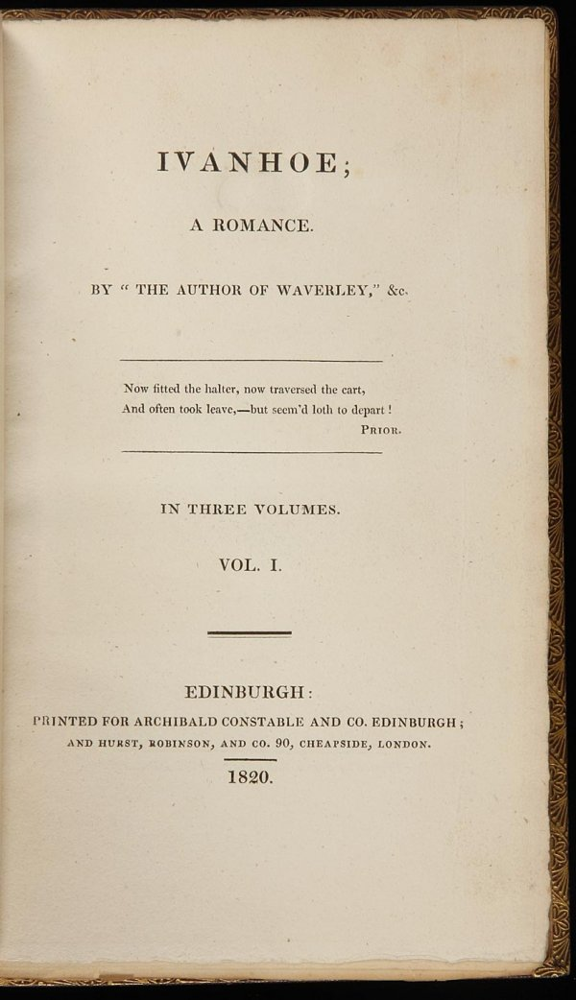
Ivanhoe (1819) by Sir Walter Scott

Slide 22
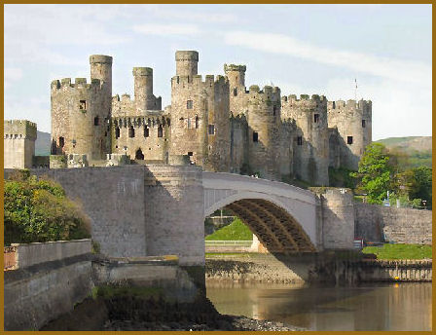
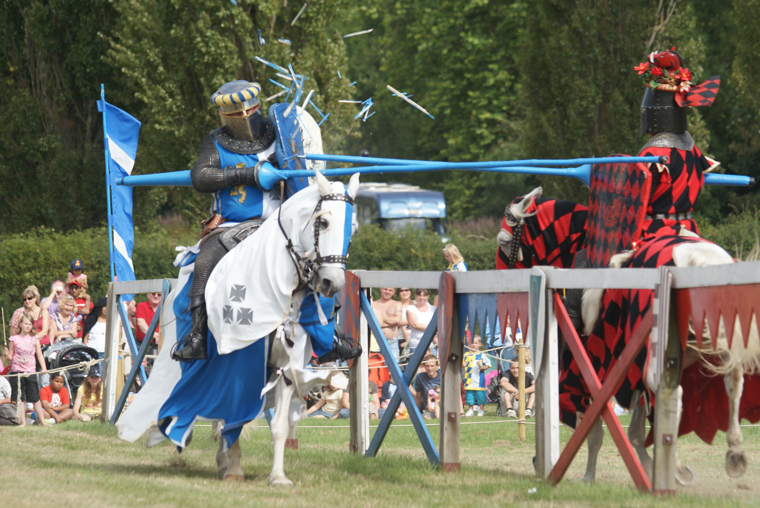
Summarise what happens in the excerpt

Slide 23
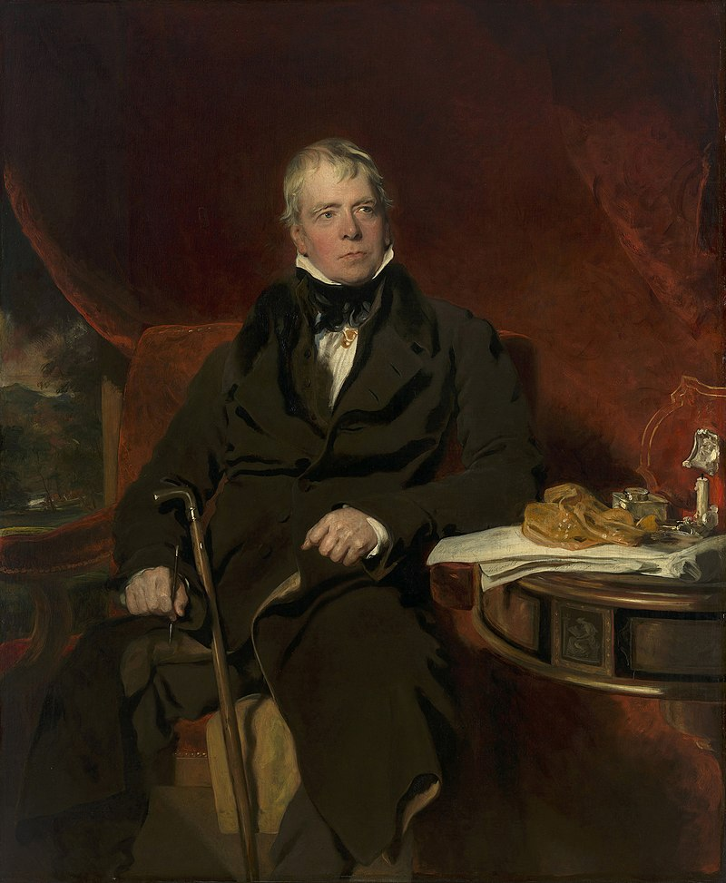
Walter Scott – (1771-1832)
He was a famous poet and novelist of his time. Many of his stories were best-selling adventures set in Scottish history.
Ivanhoe was his first novel set in English history. It is a historical romance, full of knights, chivalry, maidens to be rescued, castles, battles, and historical/legendary figures.
Wilfred of Ivanhoe is a knight returned from the Crusades in the Holy Land. He was there fighting with Richard I, who had been captured in Europe on his way back. Now, Richard’s brother, John, with the help of some scheming barons, wants to take the throne of England.
Portrait of Walter Scott in 1820

Slide 24
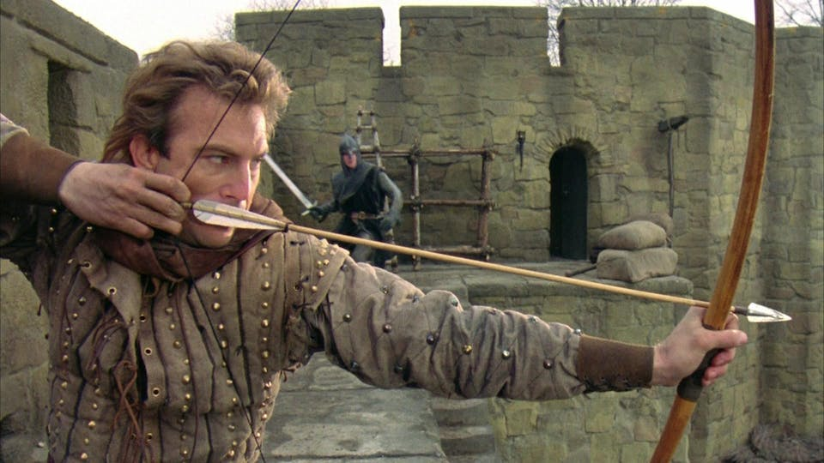
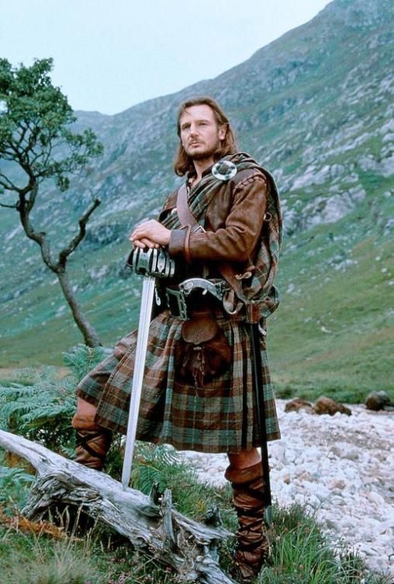
Walter Scott – (1771-1832)
Kevin Costner in Robin Hood Prince of Thieves (1991)
He staged a Scottish pageant for King George VI’s visit to Scotland and made the kilt a characteristic element. It has since been established as a part of ‘Scottish’ identity.
Liam Neeson in a film version of Rob Roy (1995) – based on Scott’s 1817 novel – wearing a tartan kilt.
The Robin Hood character in Ivanhoe was built on a long history of folk tales. However, Scott’s version added key elements, and recent films have taken much inspiration from the novel.

Slide 25
Ivanhoe – Analysis
Consider how intertextuality is involved in the telling of these scenes.
How many cases of it are there?
What effects might it have / have had in the past on readers?
How does Scott portray history, and fiction?
Are some parts more historical/fictional than others?
How does the characterisation and speech represent history?

Slide 26
Creative Writing
Write a stanza of alliterative poetry, where each line has some repeated sounds to build a rhythm: gr gr g be bea bu
Write about an Anglo-Saxon warrior like Beowulf,
or
Write about a chivalrous knight like Gawain.
Or you could try some paragraphs of prose instead. Think about how you could represent the historical periods in English.

Slide 27
Homework
Please read a few scenes of the play Romeo and Juliet (1597) by William Shakespeare.

